Slide 1
Basic Concepts
Computer Organization and Assembly Language
Lec#1
Asim Rehan
Computer Science Department
National University of Modern Languages, Islamabad

Slide 2
Overview
Welcome to COAL 2021
Assembly-, Machine-, and High-Level Languages
Assembly Language Programming Tools
Programmer’s View of a Computer System
Data Representation

Slide 3
Welcome to COAL 2021
Instructor: Asim Rehan
  Office# 20, Ghazali Block
  Email: arehan@numl.edu.pk
  Office Hours:
  LMS: Computer Organization & Assembly Language

Slide 4
Class Particulars
Credit Hours:
  Four
Course Structure:
  2 Lectures
  2 Labs each week

Slide 5


Text Books
  Computer Organization and Architecture, William Stallings, 6th Edition
  Computer Systems: A Programmer's Perspective, 3/E (CS:APP3e), Randal E.Bryant and David R.O' Hallaron, Carnegie Mellon University
Kip Irvine: Assembly Language for Intel-Based Computers
  5th edition (2007)
Read the textbook!
  Key for learning and obtaining a good grade
Notes:
Computer organization refers to the operational units and their interconnections
To be a professional in any field of computing today,
one should not regard the computer as just a black box that executes programs by magic.All students of computing should acquire
some understanding and appreciation of a computer system’s functional components, their characteristics, their performance, and
their interactions

Slide 6
Tentative Grading Policy
Class
Assignments | 10%
Quizzes | 10%
Midterm Exam | 30%
Final Exam | 50%
Lab
Lab work+Project | 60% + 40%

Slide 7
Grading Policy
All deadlines will be hard.
Re-grading can be requested after grade reporting, within following time limits:
Midterm: Same day
Assignments: 2 days
Quizzes: 2 days
On the 3rd day everything will be final

Slide 8
General Guidelines
Visit LMS course regularly for updates
Start working on projects/assignments right from the first day.
No assignments will be accepted after due date
  Students are “not” allowed to “copy” each other’s work. Any such work would be marked zero for both students. Repeated cheating can lead to F grade in course.
  If you miss an assignment/quiz/sessional there will be no way to replace it.
Come prepared in the class
Quiz can be taken at any time in class.
Read book(s)

Slide 9
Next …
Welcome to COAL 2020
Assembly-, Machine-, and High-Level Languages
Assembly Language Programming Tools
Programmer’s View of a Computer System
Data Representation

Slide 10
Some Important Questions to Ask
What is Assembly Language?
Why Learn Assembly Language?
What is Machine Language?
How is Assembly related to Machine Language?
What is an Assembler?
How is Assembly related to High-Level Language?
Is Assembly Language portable?

Slide 11
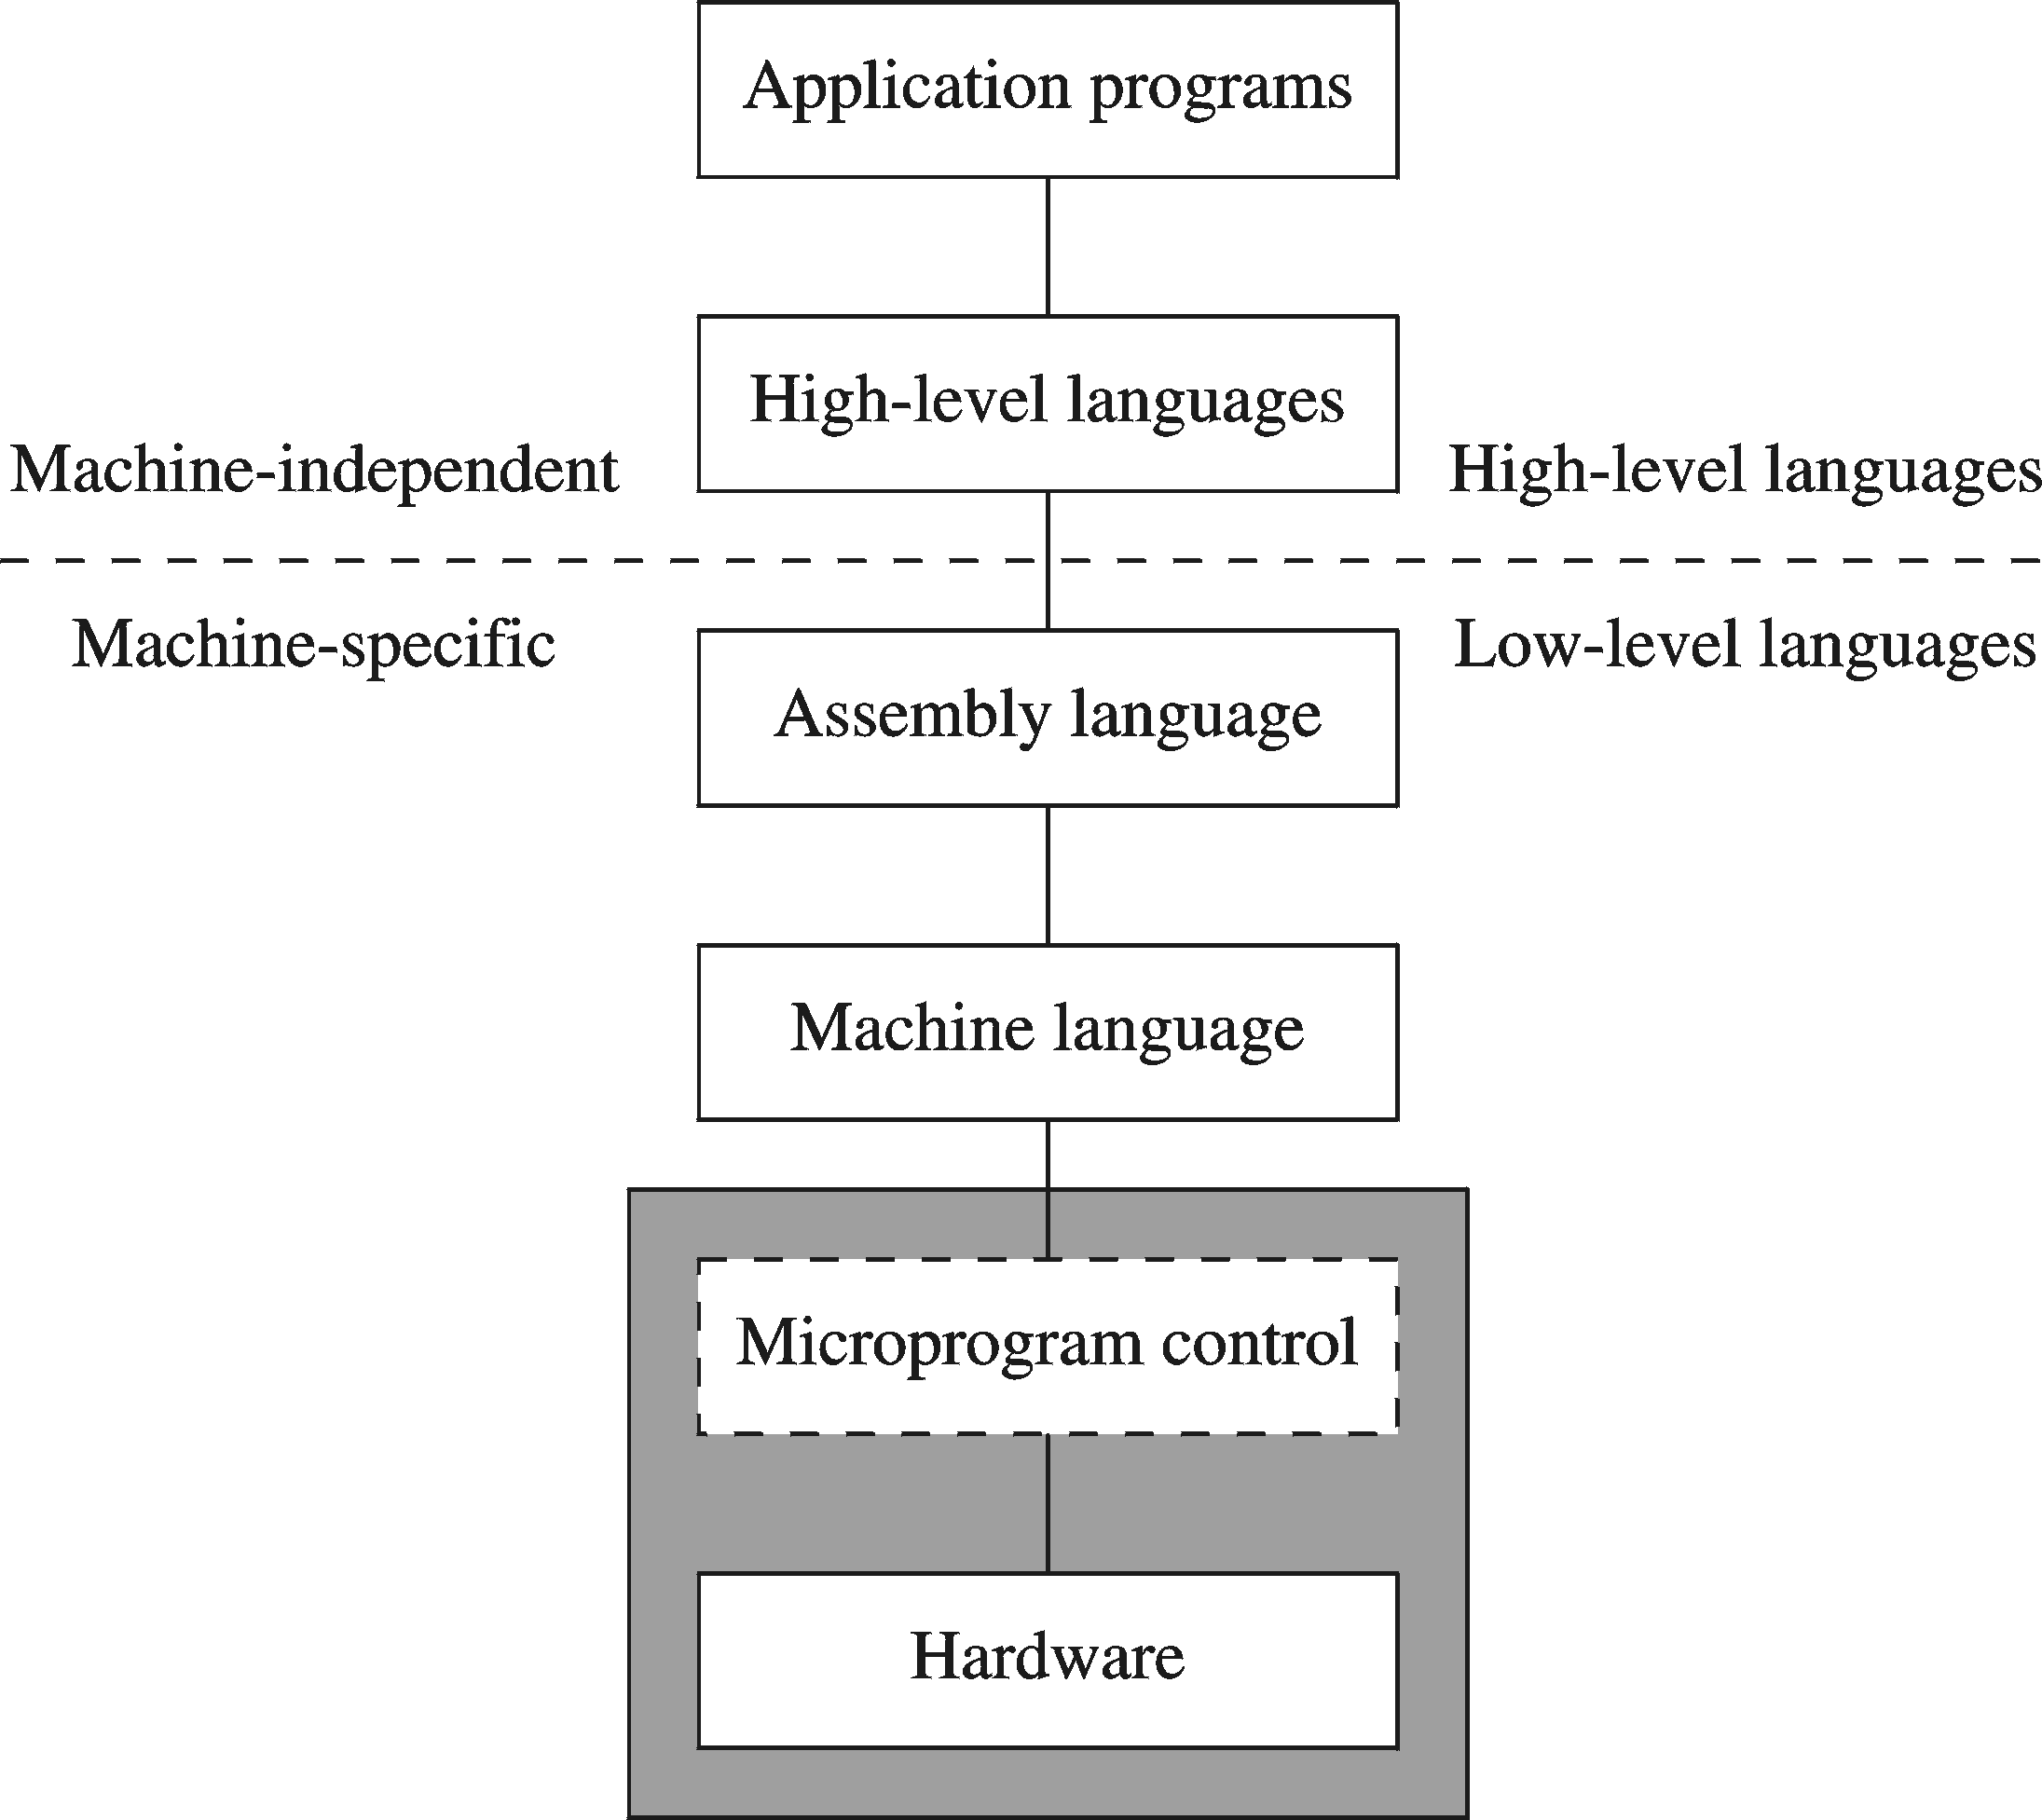
A Hierarchy of Languages
Notes:
Composed of a sequence of microinstructions corresponding to the sequence of steps in the execution of a given machine instruction.
simple logic circuit that is capable of (1) sequencing through microinstructions and (2) generating control signals to execute each microinstruction.

Slide 12
Assembly and Machine Language
Machine language
  Native to a processor: executed directly by hardware
  Instructions consist of binary code: 1s and 0s
Assembly language
  Slightly higher-level language
  Readability of instructions is better than machine language
Assemblers translate assembly to machine code
Compilers translate high-level programs to machine code
  Either directly, or
  Indirectly via an assembler

Slide 13
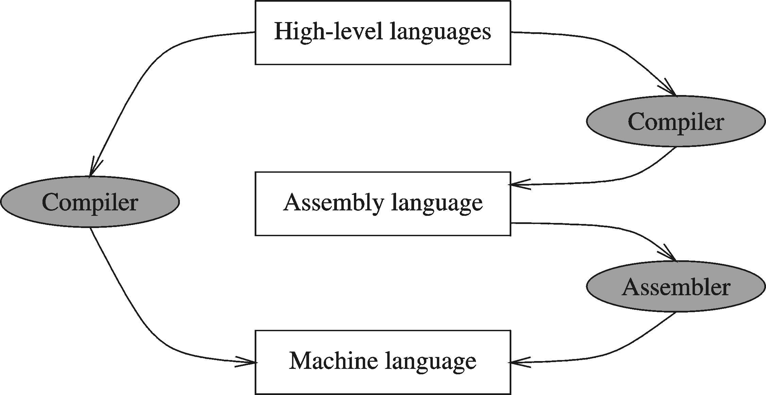
Compiler and Assembler

Slide 14
Translating Languages
English: D is assigned the sum of A times B plus 10.
High-Level Language: D = A * B + 10
A statement in a high-level language is translated typically into several machine-level instructions
Intel Assembly Language:
mov eax, A
mul B
add eax, 10
mov D, eax
Intel Machine Language:
A1 00404000
F7 25 00404004
83 C0 0A
A3 00404008

Slide 15
Advantages of High-Level Languages
Program development is faster
  High-level statements: fewer instructions to code
Program maintenance is easier
  For the same above reasons
Programs are portable
  Contain few machine-dependent details
    Can be used with little or no modifications on different machines
  Compiler translates to the target machine language
  However, Assembly language programs are not portable

Slide 16
Why Learn Assembly Language?
Two main reasons:
  Accessibility to system hardware
  Space and time efficiency
Accessibility to system hardware
  Assembly Language is useful for implementing system software
  Also useful for small embedded system applications
Space and Time efficiency
  Understanding sources of program inefficiency
  Tuning program performance
  Writing compact code

Slide 17
Next …
Welcome to COAL 2020
Assembly-, Machine-, and High-Level Languages
Assembly Language Programming Tools (Lab)
Programmer’s View of a Computer System
Data Representation

Slide 18
Next …
Welcome to COAL 2020
Assembly-, Machine-, and High-Level Languages
Assembly Language Programming Tools
Programmer’s View of a Computer System
Data Representation

Slide 19
Programmer’s View of a Computer System
Increased level of abstraction
Application Programs
High-Level Language
Level 5
Assembly Language
Level 4
Operating System
Level 3
Instruction Set
Architecture
Level 2
Microarchitecture
Level 1
Each level hides the details of the level below it
Digital Logic
Level 0

Slide 20
Programmer's View – 2
Application Programs (Level 5)
  Written in high-level programming languages
  Such as Java, C++, Pascal, Visual Basic . . .
  Programs compile into assembly language level (Level 4)
Assembly Language (Level 4)
  Instruction mnemonics are used
  Calls functions written at the operating system level (Level 3)
  Programs are translated into machine language (Level 2)
Operating System (Level 3)
  Provides services to level 4 and 5 programs
  Translated to run at the machine instruction level (Level 2)

Slide 21
Programmer's View – 3
Instruction Set Architecture (Level 2)
  Specifies how a processor functions
  Machine instructions, registers, and memory are exposed
  Machine language is executed by Level 1 (microarchitecture)
Microarchitecture (Level 1)
  Controls the execution of machine instructions (Level 2)
  Implemented by digital logic (Level 0)
Digital Logic (Level 0)
  Implements the microarchitecture
  Uses digital logic gates
  Logic gates are implemented using transistors
Notes:
ISA (instruction set architecture) is the set of instructions supported by a processor.
A microarchitecture is the hardware circuitry that implements one particular ISA.

